Slide 1
Consensus & Agreement

Slide 2
Example
Five independent sensors measure the temperature T of a furnace. Each sensor checks if T is greater than 1000◦C. Some sensors may be faulty, but it is not known which are faulty. The nonfaulty sensors have to agree about the truth of the predicate T>1000◦C (so that the next course of action can be decided).

Slide 3
Example
Alice wants to transfer a sum of $1000 from her savings account A to another account B. There are two components of this transaction: debit $1000, and credit $1000. Two distinct servers handle the two components. Transactions must be atomic—it will be a disaster if the debit operation is completed but the credit operation fails, or vice versa. Accordingly, two different servers have to reach an agreement about whether to commit or to abort the transaction.

Slide 4
Example
Consider the problem of synchronizing a set of phase clocks that are ticking at the same rate in different geographical locations of a network. Viewed as a consensus problem, the initial values (of phases) are the set of local readings (which can be arbitrary), but the final phases must be identical.

Slide 5
Example
  The classic formulation of this process is the Byzantine Generals problem: a decision whether multiple armies should attack or retreat, assuming that united action will be more successful than some attacking and some retreating.

Slide 6
Problem Formulation
A distributed system contains n processes {0, 1, 2, . ., n−1}. Every process has an initial value in a mutually agreed domain. The problem is to devise an algorithm such that despite the occurrence of failures, processes eventually agree upon an irrevocable final decision value that satisfies the following three conditions:
Termination. Every nonfaulty process must eventually decide.
Agreement. The final decision of every nonfaulty process must be identical.
Validity. If every nonfaulty process begins with the same initial value v, then their final decision must be v.
The consensus requires agreement among non faulty members only—we do not care about the faulty member

Slide 7
Consensus
Failure handling during consensus is a key concern
In the absence of failures or faulty processors, values (that is to be decided) can be exchanged. A vote can be taken and decision/agreement can be made based on: majority, minimum vote, mean, etc.
Presence of failure: processors can fail or misbehave intentionally. Several rounds of message exchanges might be needed before agreement can be reached.

Slide 8
System Model
n processors in the system with at most m of them being faulty.
Processors can exchange messages directly (no need to go through another processor).
Receiver knows the identity of the sender.
Communication medium is reliable: messages are delivered without errors.

Slide 9
Synchronous Computation
Processes run in lock step manner, or in rounds.
In each step/round i, processes receive messages that were sent in the previous step/round i-1.
Processes then do some computation and send out messages, that will be received in step/round i+1.
Agreement protocols to be discussed assume synchronous computation.
Asynchronous computation: A process can send, receive, and perform computation at any time.

Slide 10
Other Assumptions
Processor can fail in 3 modes:
  Crash fault: functioning stops (timeouts can be used).
  Omission fault: a processor “omits” actions, e.g., misses to send a message to 2 out of 5 processors.
  Malicious fault: a processor can send fictitious messages or modify values in a message, intentionally. Also called Byzantine faults.
Type of messages:
  Authenticated messages: a faulty processor cannot modify/forge a message.
  Non-authenticated messages: messages can be forged.

Slide 11
Types of Agreement Problems
Byzantine Agreement Problem
  A single value is to be agreed upon.
  Initial value to be proposed by an arbitrary processor: all non-faulty processors need to agree on that value.
Consensus Problem
  Every processor has its own initial value.
  All non-faulty processors agree on a common value
Interactive Consistency Problem
  Every processor has its own initial value.
  All non-faulty processors agree on a set of common values (or) a vector.

Slide 12
Consensus Requirements
Termination—eventually each correct process sets its decision variable
Agreement—the decision variable of all correct processes is the same
Integrity—if the correct processes all proposed the same value v, then any correct process has agreed on that value v

Slide 13
Byzantine General Requirements
( The Byzantine Generals problem deals with reaching consensus in presence of byzantine failures. )
Termination—eventually each correct process sets its decision variable
Agreement—the decision variable of all correct processes is the same
Integrity—if the commander is correct, then all correct processes agree on the value that the commander has proposed

Slide 14
Interactive Consistency Requirements
  Termination—eventually each correct process sets its decision variable
  Agreement—the decision vector of all correct processes is the same
  Integrity—if any process is correct, then all correct processes decide the correct value for that process

Slide 15
Above three types are closely related. Byzantine agreement problem forms the basis of other 2 types. We focus on Byzantine agreement.

Slide 16
Linking the problems
Consensus (C), Byzantine Generals (BG), and Interactive Consistency (IC) are all problems concerned with making decisions in the context of arbitrary or crash failures.
We can sometimes generate solutions for one problem in terms of another. For example.
We can derive IC from BG by running BG N times, once for each process with that process acting as commander.

Slide 17
Derived Solutions
We can derive C from IC by running IC to produce a vector of values at each process, then applying a function to the vector’s values to derive a single value.
We can derive BG from C by
  Commander sends proposed value to itself and each remaining process
  All processes run C with received values
  They derive BG from the vector of C values

Slide 18
Byzantine Generals Problem in Synchronous System
An arbitrary source processor broadcasts its initial value to all others.
Processes communicate with each other.
The state of a decision variable is set
If the source processor is faulty, other non-faulty processor can agree on any common value.
Faulty processes can exhibit arbitrary failures
If faulty processors are in majority, then non-faulty processors cannot reach an agreement.

Slide 19
Solution With Traitors: Interactive Consistency Requirements
IC1. Every loyal lieutenant receives the same order from the commander.
IC2. If the commander is loyal, then every loyal lieutenant receives the order that the commander sends.

Slide 20
Impossible Scenario/
An Impossibility Result (Byzantine Agreement)
Consider a system with 3 processors: p0, p1, p2.
Two possibilities:
  Case 1: p0 (source) is not faulty. p2 is faulty. p1 should agree upon 1 as the value. Not possible.
  Case 2: p0 is faulty. p1 may agree on 1 and p2 on 0.
Case 1:
Case 2:
p0
p2
1
1
1
1
1
0
p1
p2
p1
p0
0
0

Slide 21
Four Byzantine generals
p
(Commander)
p
(Commander)
1
1
1:v
1:v
1:u
1:w
1:v
1:v
2:1:v
2:1:u
p
3:1:u
p
p
3:1:w
p
2
3
2
3
4:1:v
4:1:v
4:1:v
4:1:v
2:1:v
3:1:w
2:1:u
3:1:w
p
p
4
4
Faulty processes are shown coloured

Slide 22
Limits for solutions to Byzantine Generals
Number of faulty processors, m, cannot exceed: trunc[(n-1)/3].
needs at least (m+1) rounds of message exchange (lower bound result)
Lamport et al found that if there are only 3 processes, there is no solution.
Pease et al found that if the total number of processes is less than three times the number of failures plus one, there is no solution. Thus there is a solution with 4 processes and 1 failure, if there are two rounds. In the first, the commander sends the values, while in the second, each lieutenant sends the values it received

Slide 23
Oral Messages Model
The oral message model satisfies the following three conditions:
1. Messages are not corrupted in transit.
2. Messages can be lost, but the absence of message can be detected.
3. When a message is received (or its absence is detected), the receiver knows the identity of the sender (or the defaulter).

Slide 24
Lamport’s Algorithm
Recursive Algorithm referred to as Oral Message Algorithm: OM(m), m > 0. For 3m + 1 or more processors of which m are faulty.
S is the set of generals for which we want agreement
  Algorithm OM(0,S)
    Source processor i sends its value to every processor j in {S-i}.
    Each processor accepts the value it receives from source. (If no value received, default value of 0 assumed).

Slide 25
  Algorithm OM(m,S), m > 0
    Source processor i sends its value to every processor {S- i}
    For each processor j, let vj be the value received by processor j from i. Processor j acts as new source. Process j initiates OM(m-1,S-i) with j acting as the source.
    When Step 2 has been completed by all processes Let vj be the value received by Pi from Pj in above step. (If no value received, vj is assumed to be 0). Pi uses majority (v1, v2, ..vn-1).

Slide 26
Lamport’s Algorithm ...
Processors are successively divided into smaller groups in step 2 where OM(m-1) is executed.
Step 3 is executed during the folding phases of recursion where a majority function selects the agreed value (among those received in step 2).
Note: majority returns 0 if one does not exist.
Number of messages:
  Message complexity: O(n power m).

Slide 27
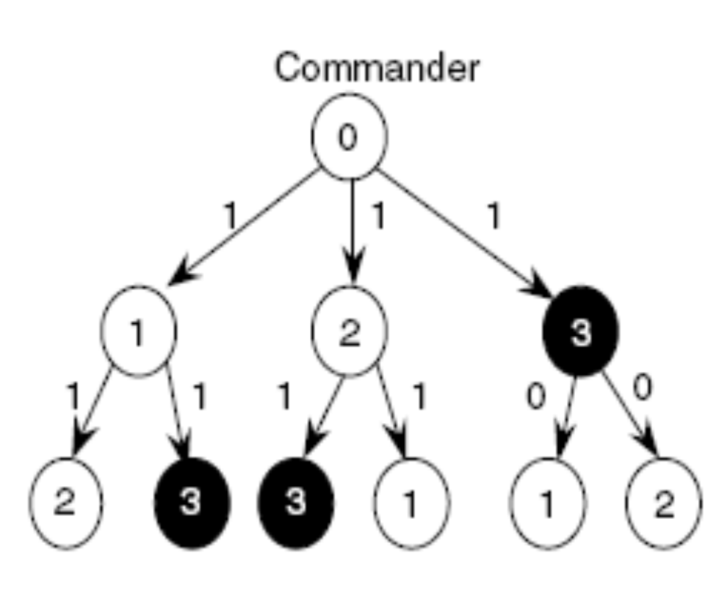
An example of the execution of the OM(m) algorithm with m=1 and n = 4

Slide 28
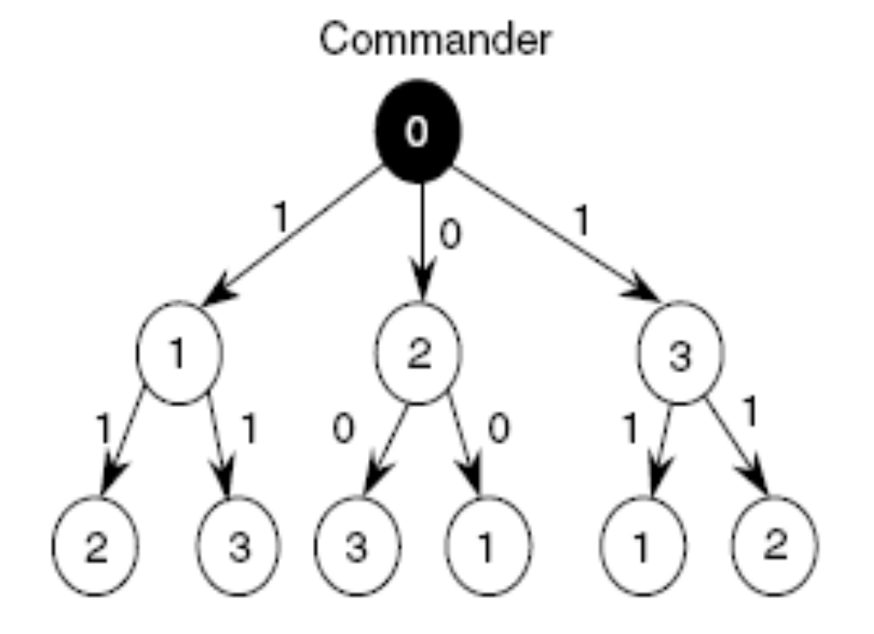
An example of the execution of the OM(m) algorithm with m=1 and n = 4

Slide 29
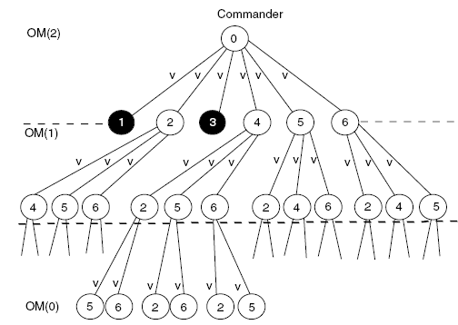
An example of the execution of the OM(m) algorithm with m=2 and n = 7

Slide 30
Asynchronous Systems
All solutions to consistency and Byzantine generals problems are limited to synchronous systems.
Fischer et al found that there are no solutions in an asynchronous system with even one failure.
Why can’t consensus be guaranteed in an asynchronous environment?
Messages have arbitrary delay, processes arbitrarily slow (no timeouts!)
Hence, Consensus is Impossible to achieve!
  even a single failed process is enough to avoid the system from reaching agreement!
This impossibility is circumvented by masking faults or using failure detection.

Slide 31
With authenticated messages Byzantine consensus is possible with any number of faulty nodes Argue informally why this is true
Each loyal node can detect when traitors send inconsistent values
If the general is loyal then the loyal lieutenants will get the same values from the general and from the other lieutenants since no traitor can sign a different message from the general Thus agreement is achieved
If the general is a traitor then two lieutenants can receive conflicting orders from the general The lieutenants exchange this information and apply the same choice function to this information again coming to consensus

Slide 32
Total Ordering With Logical Clocks
Problem: It can happened that two event happen at the same (logical) time. Avoid this by attaching a node number to an event:
Pi timestamps each event e with Ci(e),.i
Then: Ci(a),i → Cj(b),j iff:
Ci(a) < Cj(a), or
Ci(a) = Cj(b) and i < j
Lamport gives an approach to defining a total order on events in a distributed system Explain briefly how this total ordering could be agreed upon by all nodes in the system in the face of Byzantine failures

Slide 33
The nodes can use the solution to the Byzantine Generals problem to come to consensus on the source and logical clock assigned to each event In detail rather than just sending the bit information attack/retreat from the original Byzantine Generals problem the nodes come to agreement on the source and clock values for each event With Lamports happened before function the nodes can come to agreement on the total order This is assuming that there are at least m nodes when m nodes can fail

Slide 34
Lamport’s Algorithm: Example 1
System with 4 processors: p0, p1, p2, p3. p0 is source, p2 is faulty.
Assumption: possible values are only 1 and 0.
Step 1: p0 initiates the initial value to be 1. (Algorithm OM(1), m =1).
Step 2: OM(0). p1 sends 1 to {p2, p3}. p3 sends 1 to {p1,p2}
p2 (the faulty one) sends 1 to p1 and 0 to p3.
Step 3: majority function at p1 and p3 is 1, which is the desired result. (Not bothered about p2, the faulty one).
p0
p0
1
1
1
1
1
1
1
0
p1
p2
p3
p1
0
p2
p3
1
1
1

Slide 35
Lamport’s Algorithm: Example 2
System with 4 processors: p0, p1, p2, p3. p0 is source, and is faulty.
Assumption: possible values are only 1 and 0.
Step 1: p0 initiates the initial value to be 1 for p1 and p3. For p2, it sends a 0(Algorithm OM(1), m =1).
Step 2: OM(0). p1 sends 1 to {p2, p3}. p3 sends 1 to {p1,p2}
p2 sends 0 to p1 and p3.
Step 3: majority function at p1, p2, p3 is still the same (1), which is the desired result.
p0
1
1
0
1
0
p1
p2
p3
0
1
1
1

